Slide 1
Project Report Clustering based Data Analysis
CMPS 451/551 Data Mining
Team NeNai
Olisemeka Nmarkwe
Sujana Mehta.

Slide 2
DESCRIPTION
Goal: Exploration of EEG hand-crafted feature space for identification of individuals.
Tasks:
Visualize signals
Preprocess signals
Design representation
Extract features
Explore feature distributions
Design and create the clusters.
Conduct model assessment

Slide 3
Problem Definition
The objective of this project is to develop a modular and scalable pipeline for preprocessing and feature extraction from EEG data, leveraging advanced signal processing techniques. The pipeline integrates clustering algorithms such as k-means, hierarchical, and DBSCAN, with evaluation metrics including cohesion, separation, silhouette scores, and Davies-Bouldin index to ensure robust, reproducible, and interpretable exploratory analysis. The project aims to facilitate insights into EEG patterns and their applications in neuroscience and machine learning.

Slide 4
Data Preprocessing
This 4 filters were being used on our data
Notch Filtering: Removes powerline interference (60 Hz and harmonics).
Impedance Filtering: Filters noise caused by impedance mismatch.
Bandpass Filtering: Retains frequencies between 0.5 Hz and 32 Hz.
Re-referencing: Centers the signals to remove bias.

Slide 5
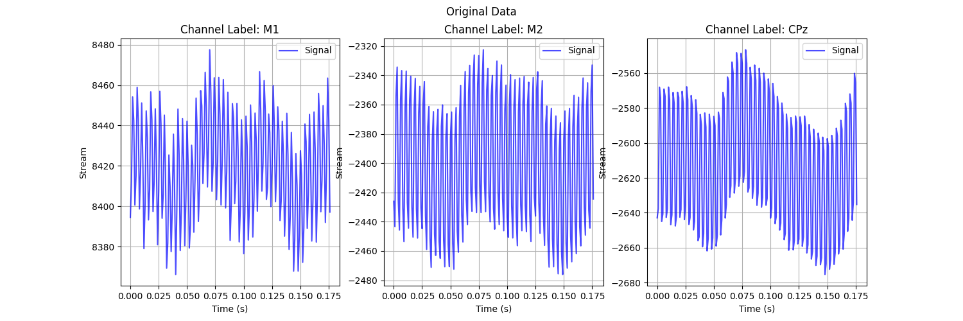
Original Data : Channels M1, M2 & CPz

Slide 6
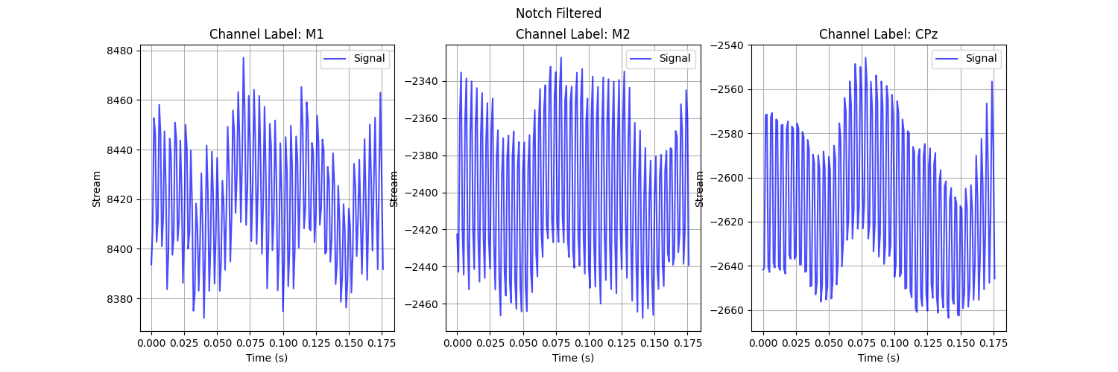
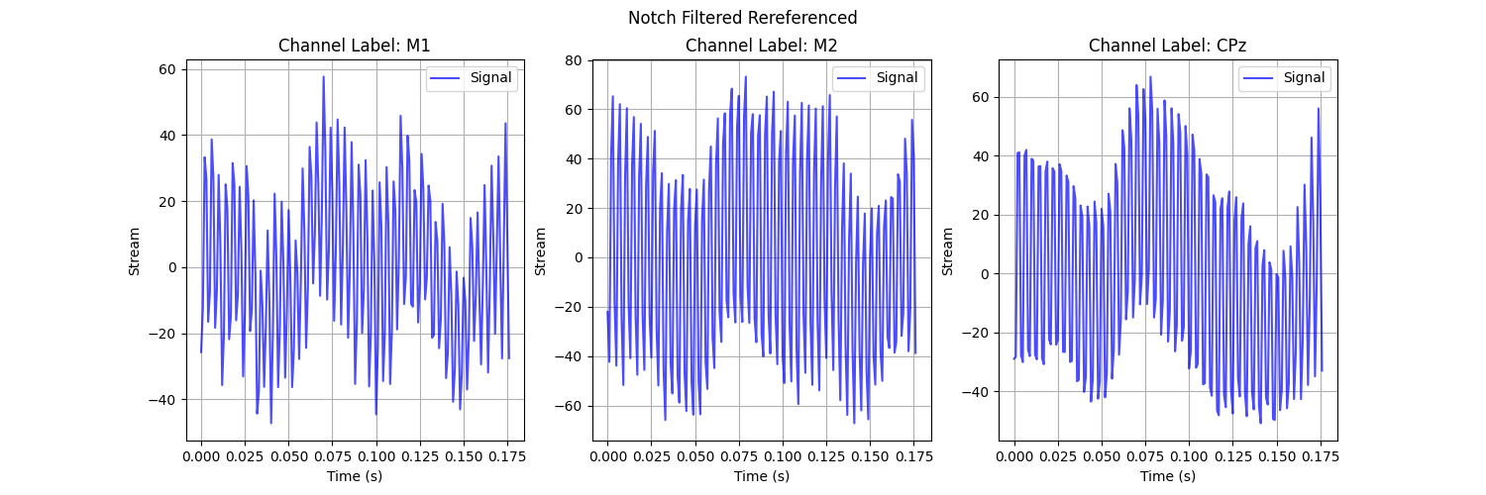
Here we have notch filter notch_frequencies = [60, 120, 180, 240]
added and in the bottom figure the filter is re-referenced

Slide 7
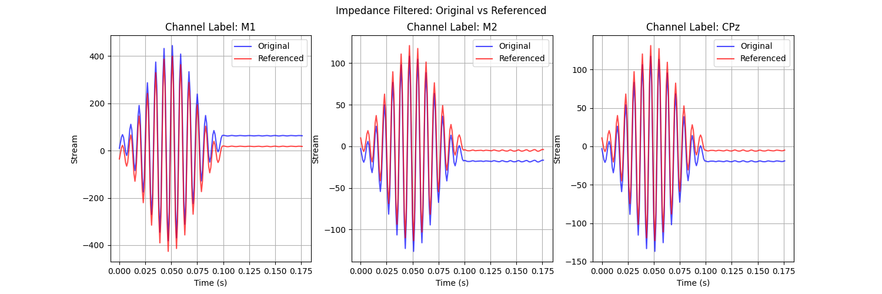
Here we have the impedance filter impedence_limits = [124, 126]
and we plot the re-reference over the original.

Slide 8
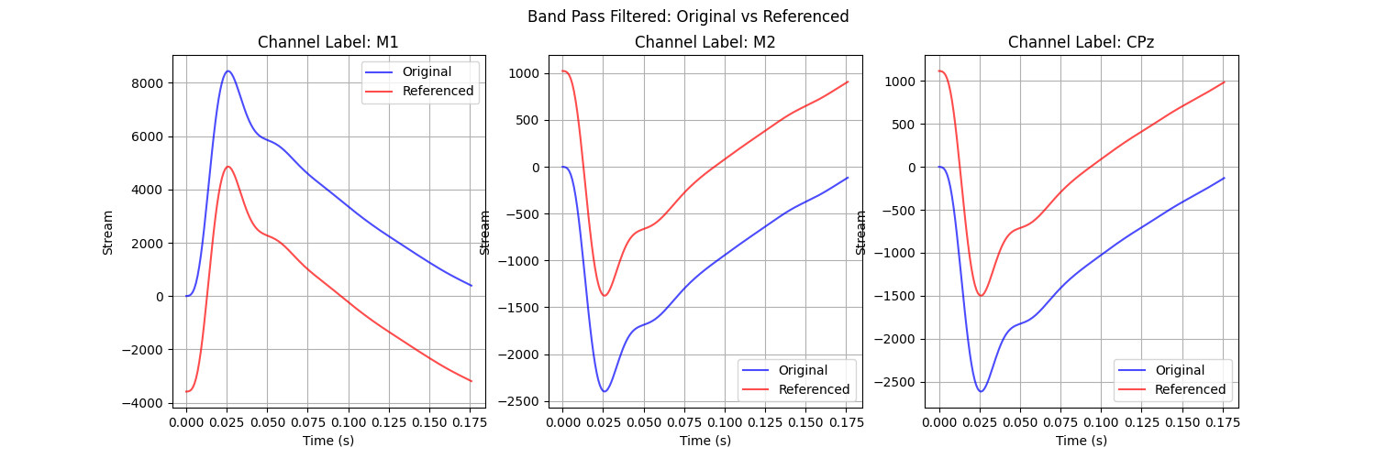
This is the bandpass band_pass_limits = [0.5, 32]
filter for the channel with the re-referenced on the same plot

Slide 9
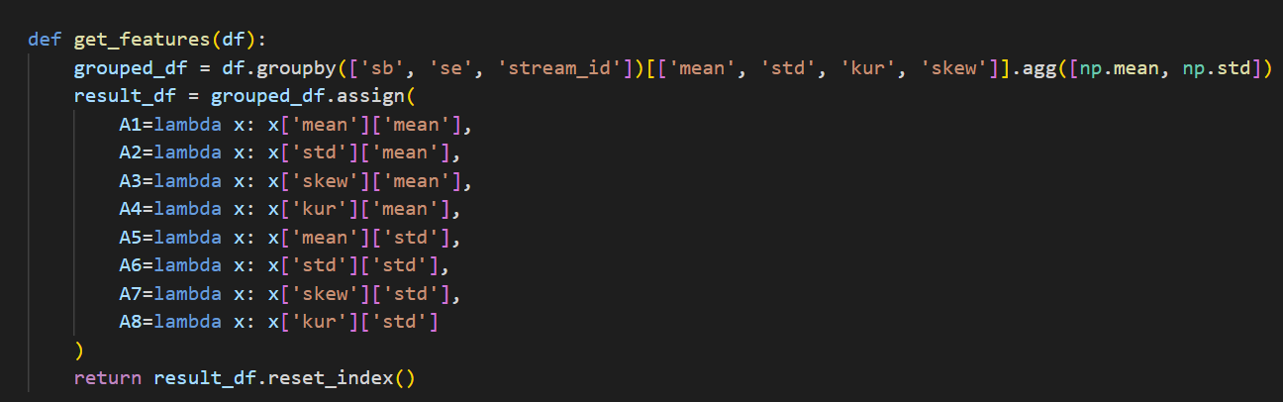
Generate Features
Feature Extraction:
Extracts statistical features mean & std of (mean, std, kurtosis, skewness) for each signal window.
Aggregates these features to produce higher-level statistics (A1 through A8).

Slide 10
Data Description
ATTRIBUTE NAME | TYPE
sb | Categorical (Subject Identifier)
se | Categorical (Session Identifier)
stream_id | Integer
A1 | Continuous (Mean of Means)
A2 | Continuous (Standard Deviation of Means)
A3 | Continuous (Mean of Standard Deviations)
A4 | Continuous (Standard Deviation of Standard Deviations)
A5 | Continuous (Mean of Kurtosis)
A6 | Continuous (Standard Deviation of Kurtosis)
A7 | Continuous (Mean of Skewness)
A8 | Continuous (Standard Deviation of Skewness)
target | Categorical (Class Label: Sb1 or Sb2)

Slide 11
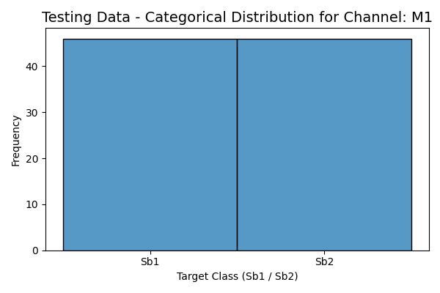
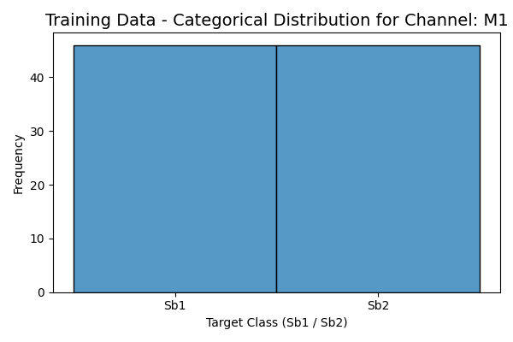
Histograms: Categorical distribution for M1

Slide 12


Histograms: Categorical distribution for M2

Slide 13


Histograms: Categorical distribution for CPz

Slide 14
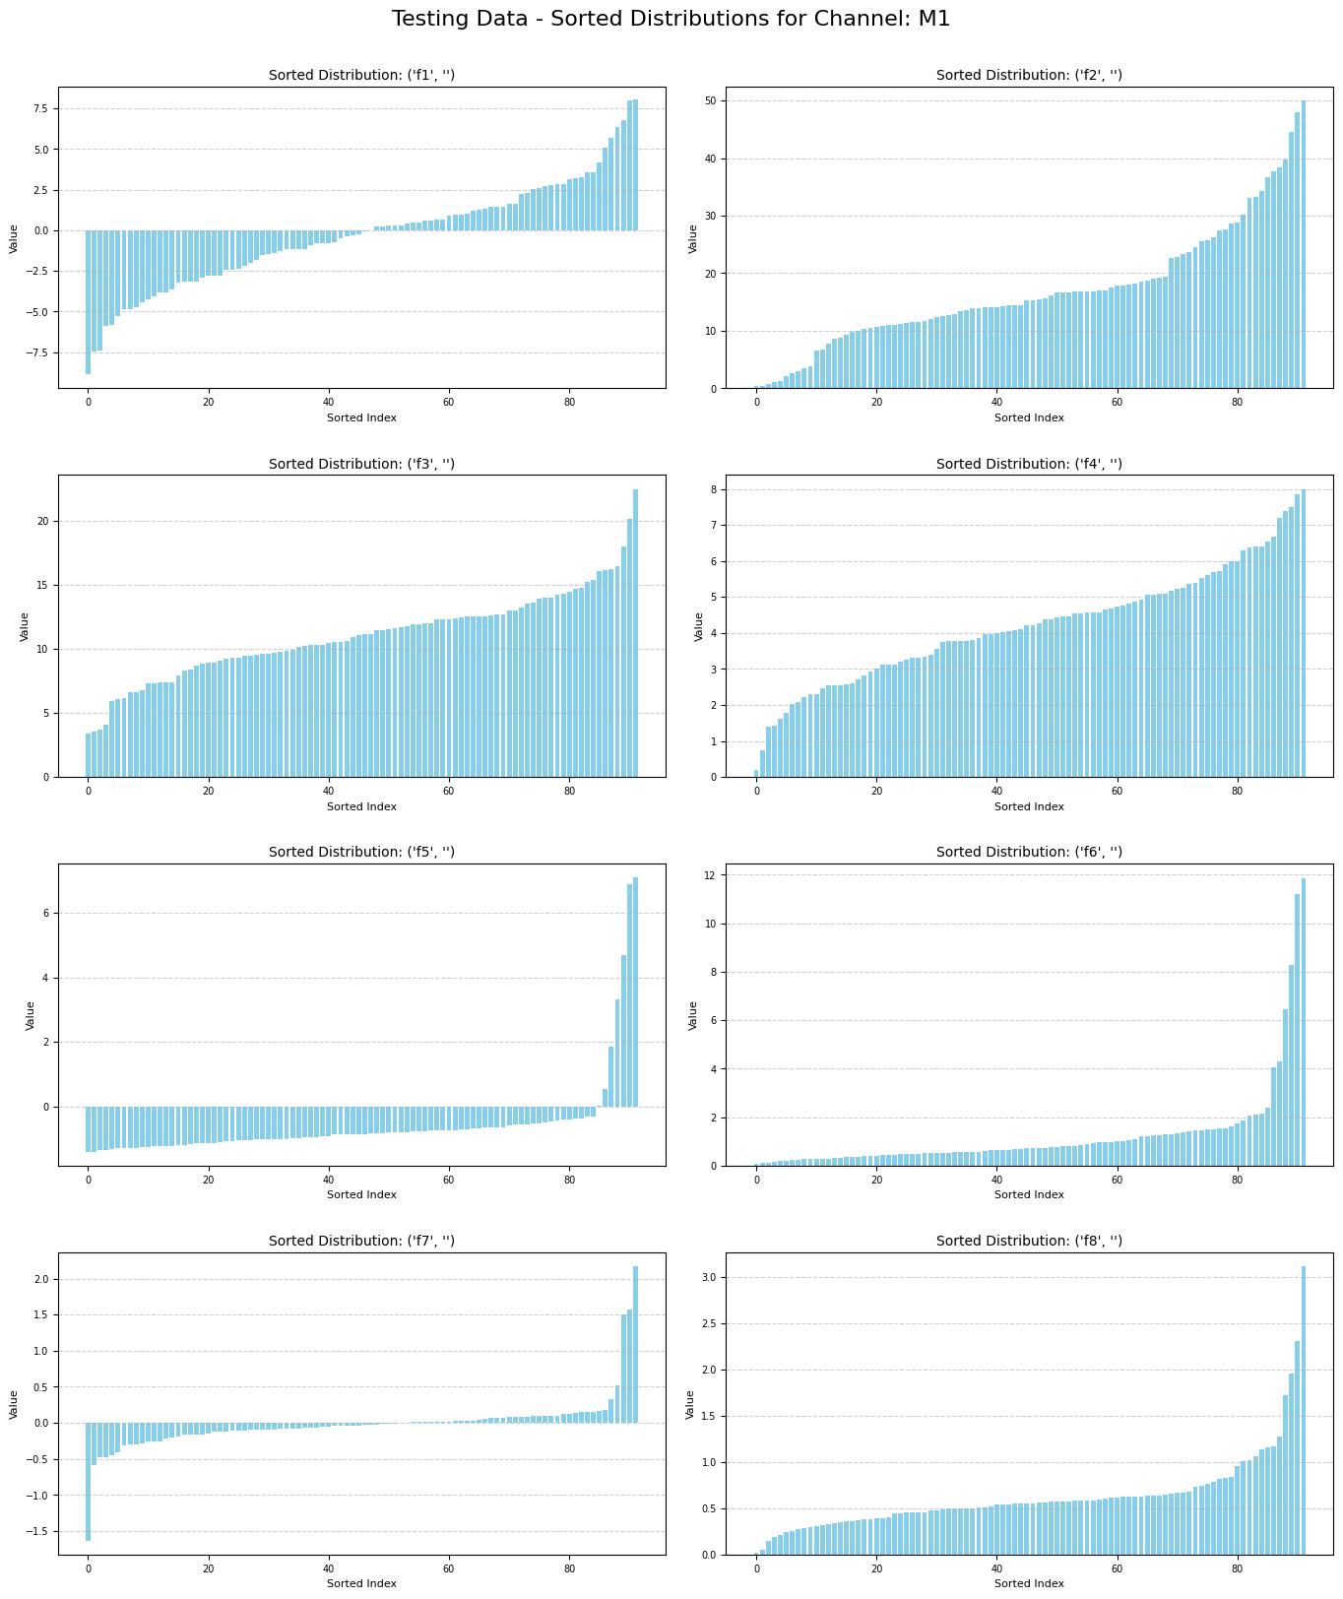
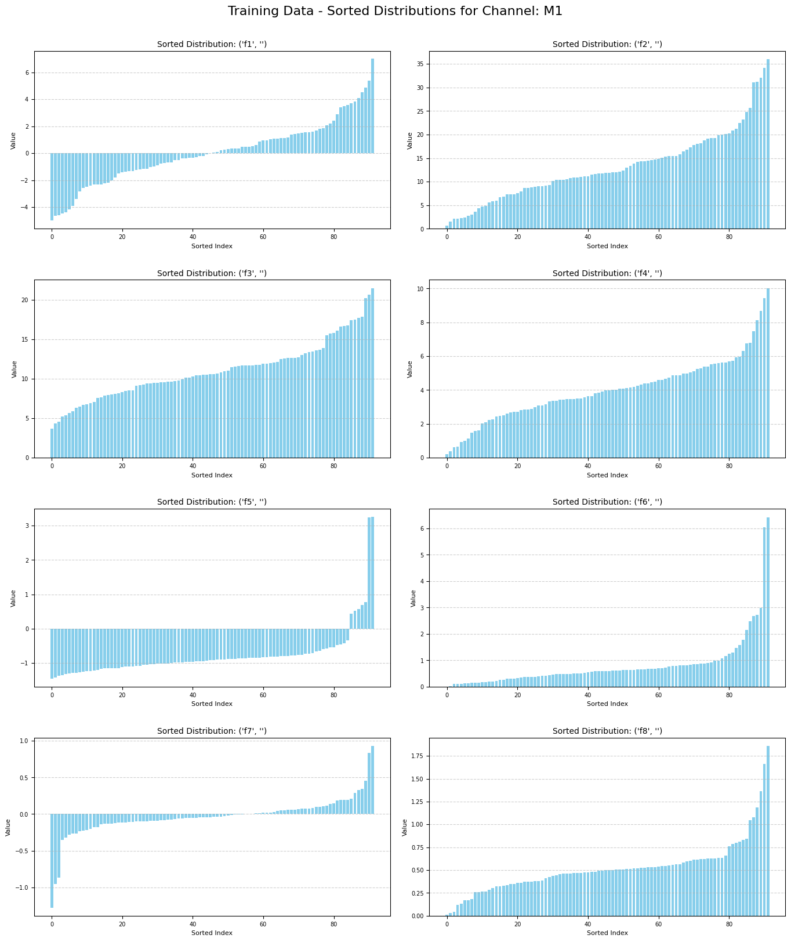
Visualization: Sorted Distribution for M1

Slide 15
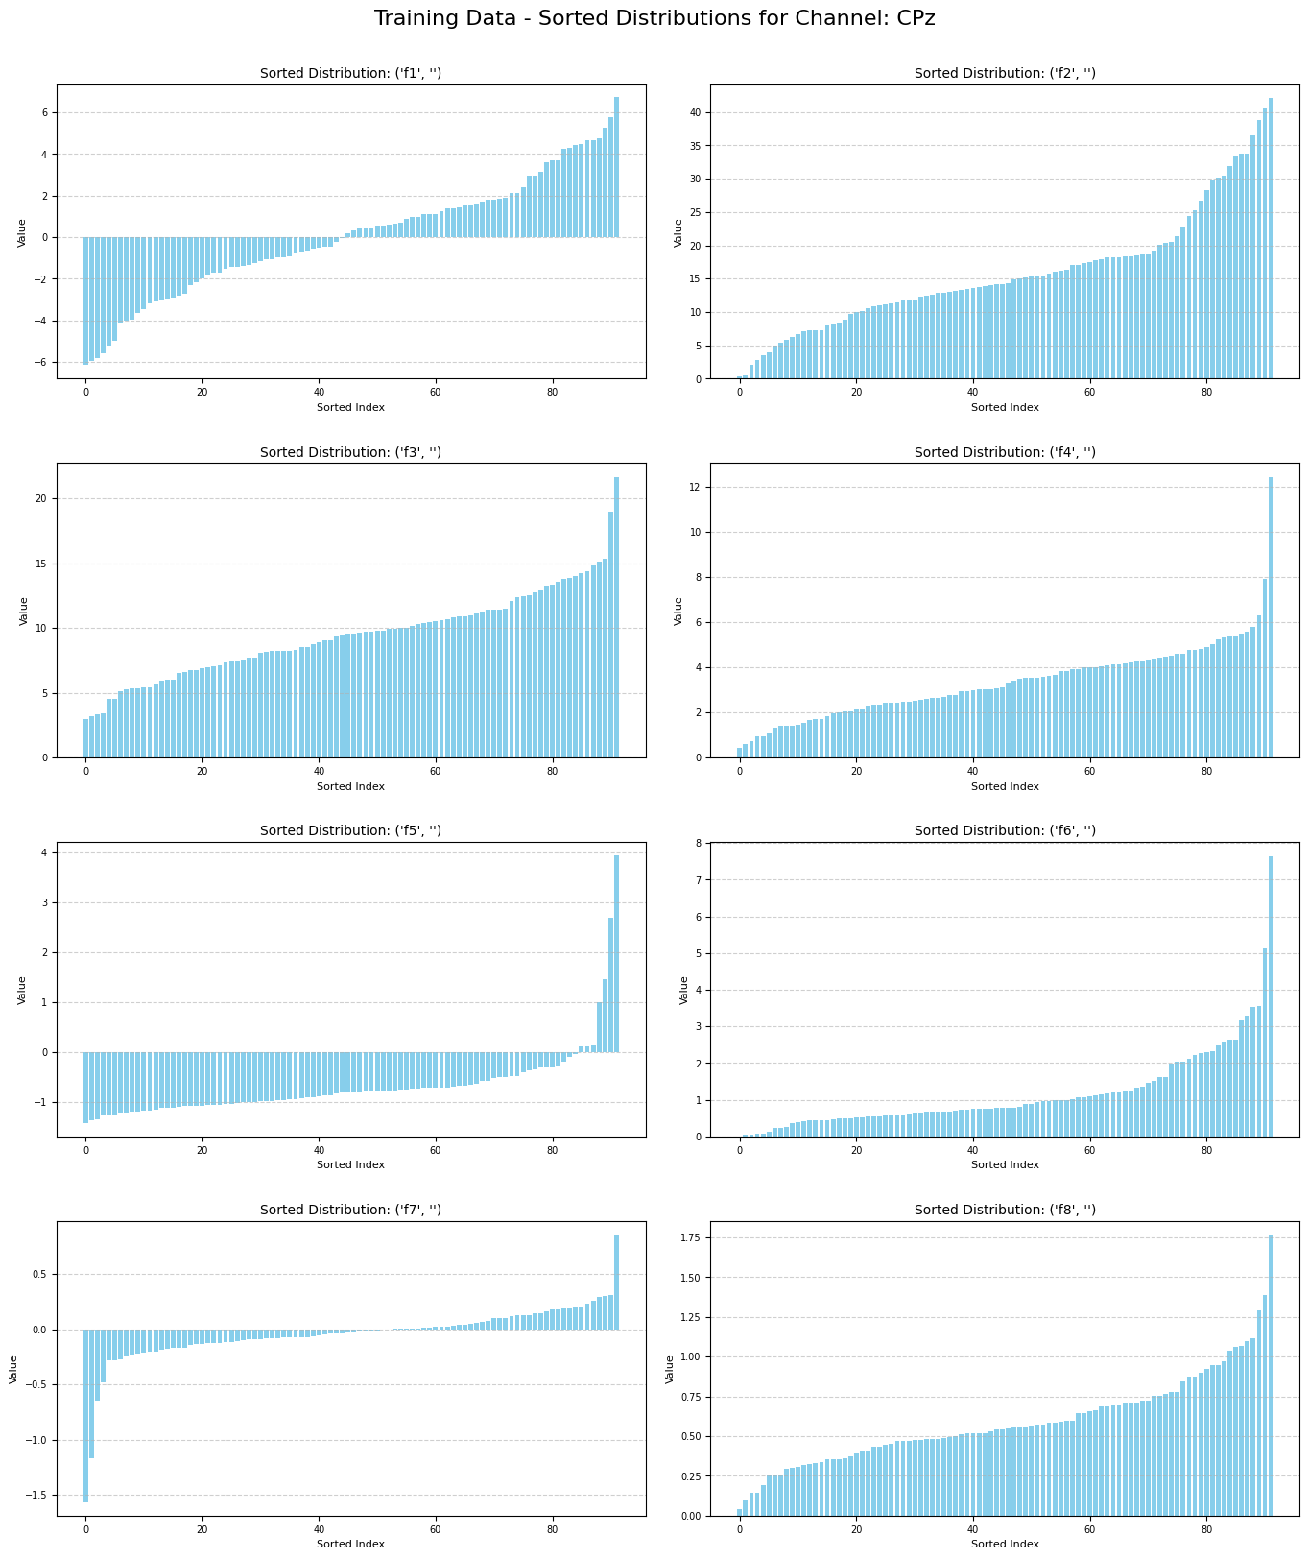
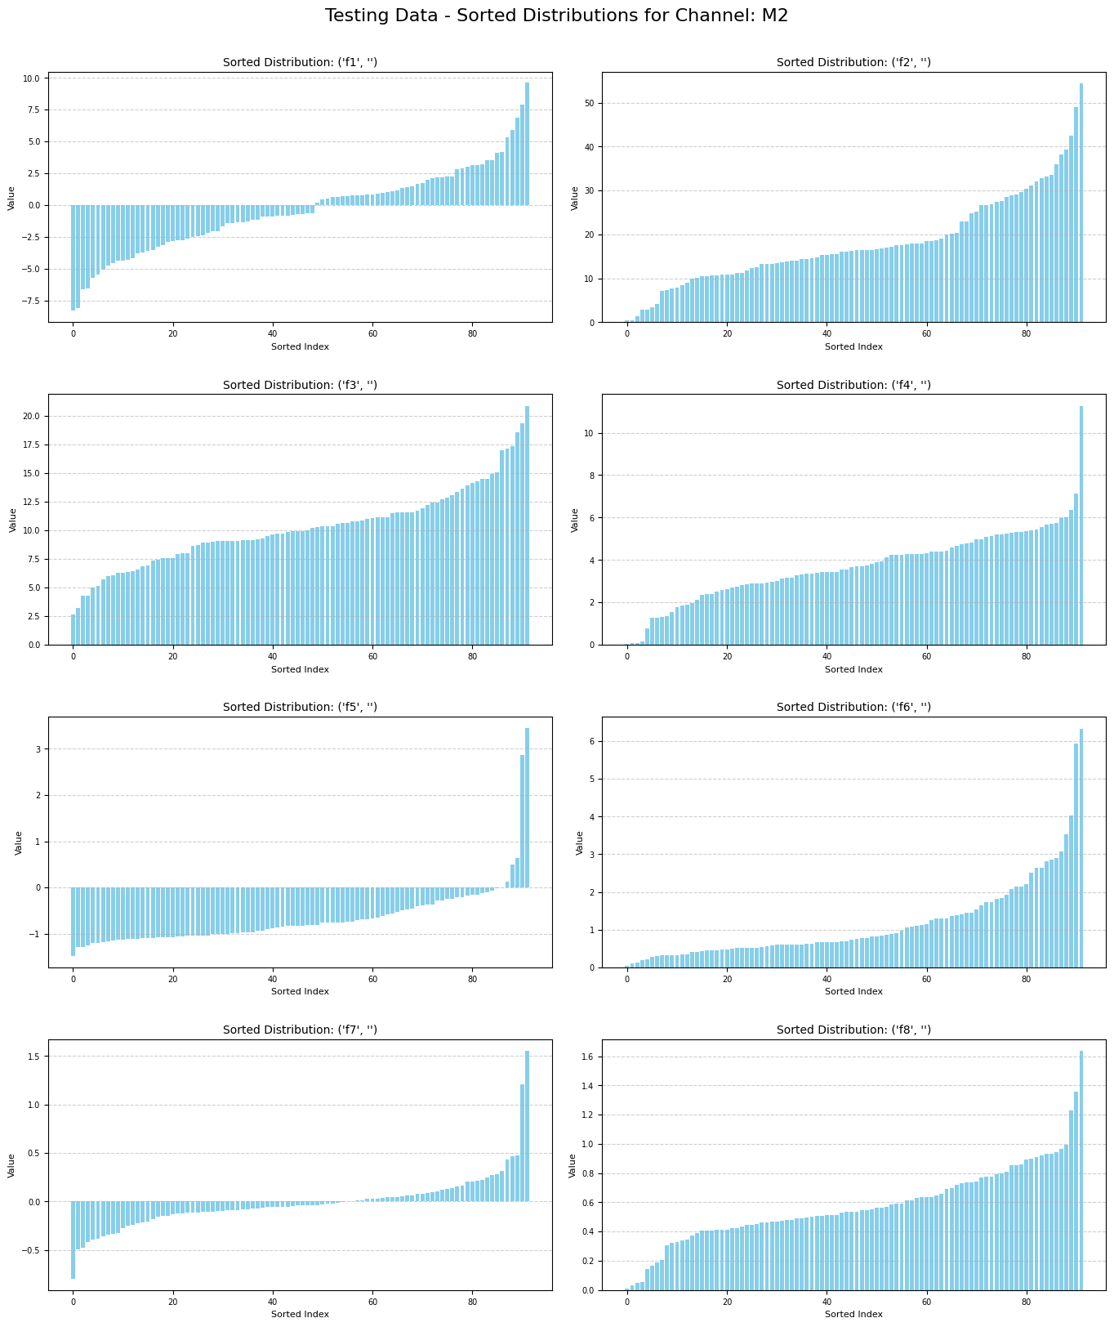
Visualization: Sorted Distribution for M2

Slide 16
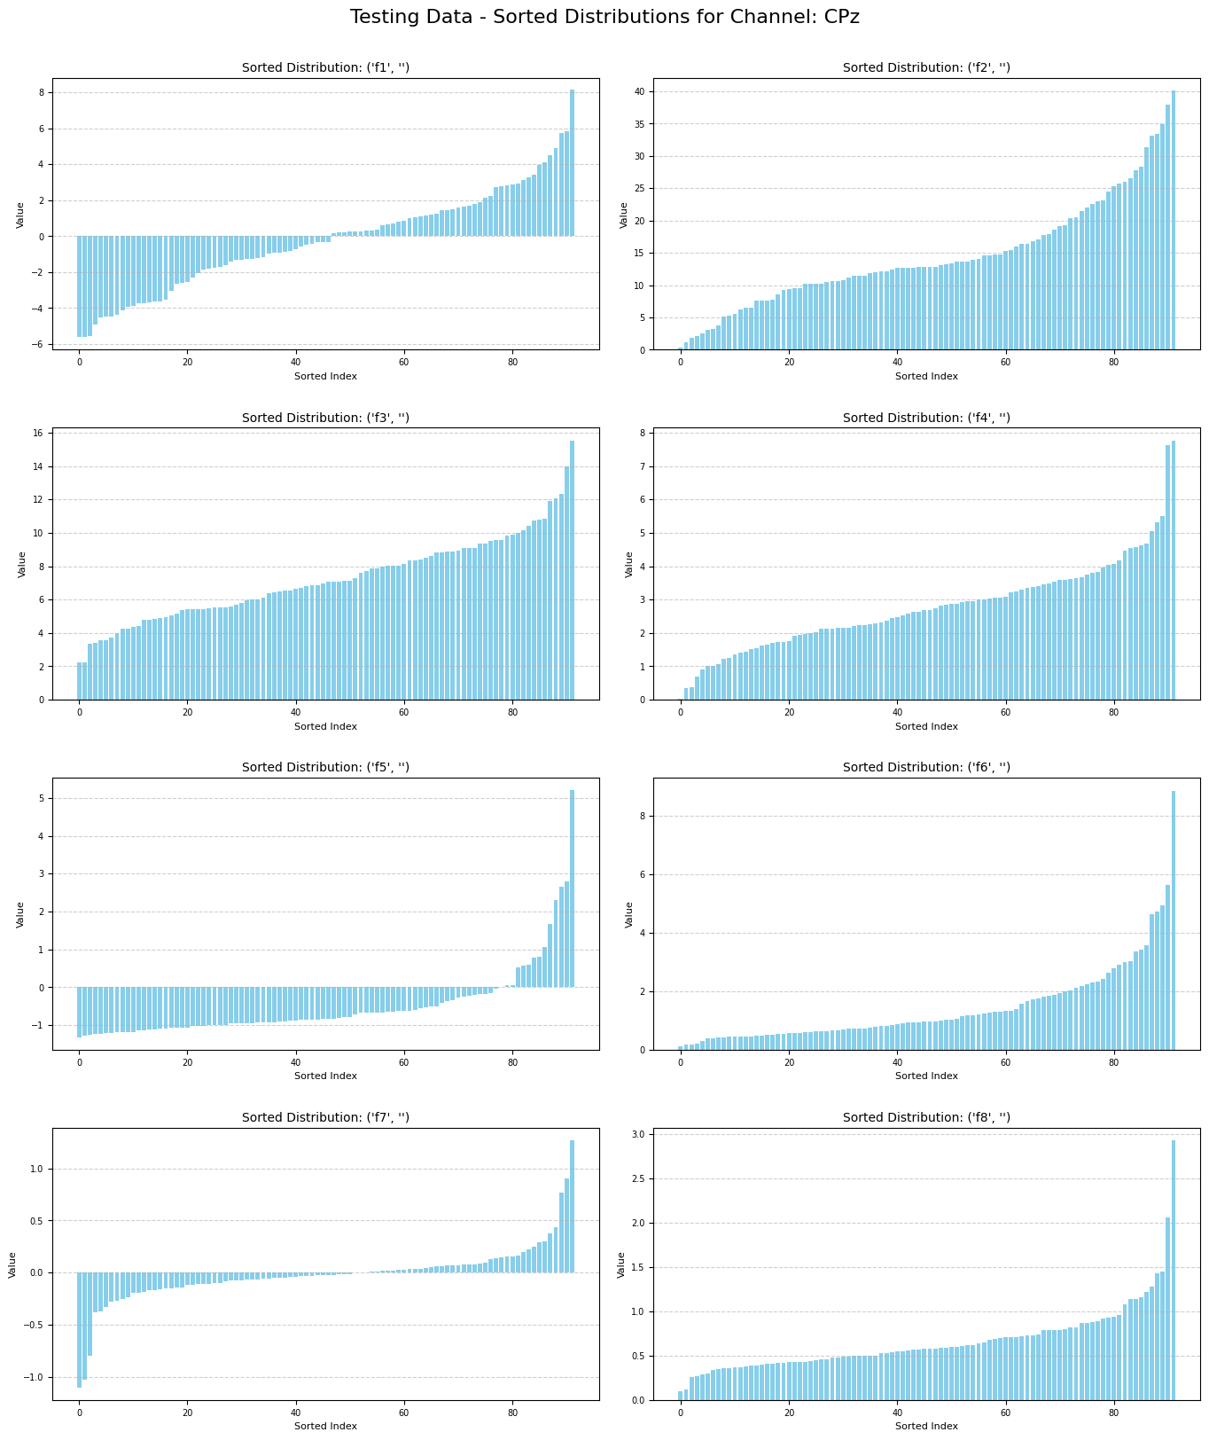
Visualization: Sorted Distribution for M1

Slide 17
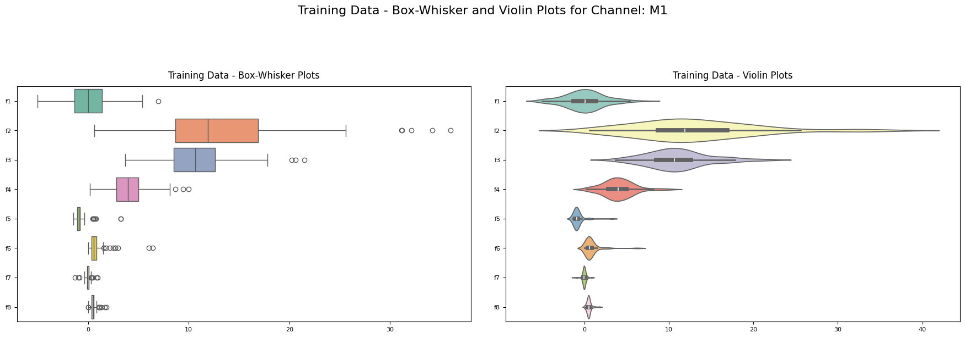
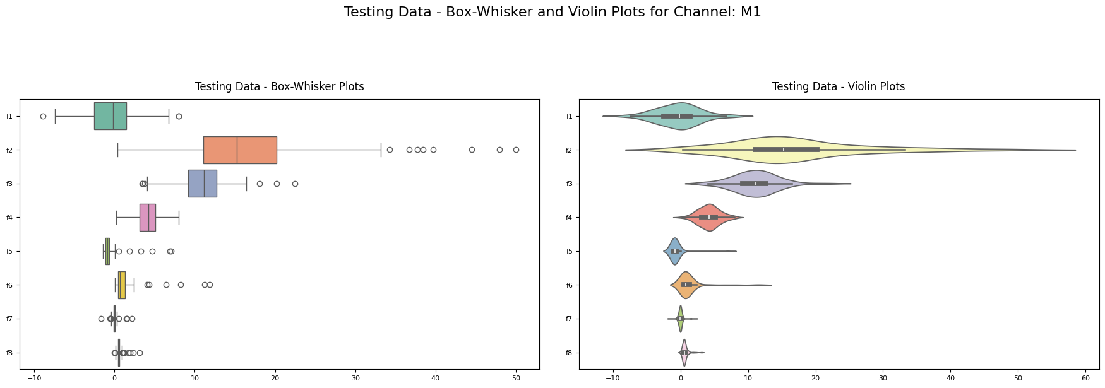
Box-Whisker & Violin Plots for M1

Slide 18
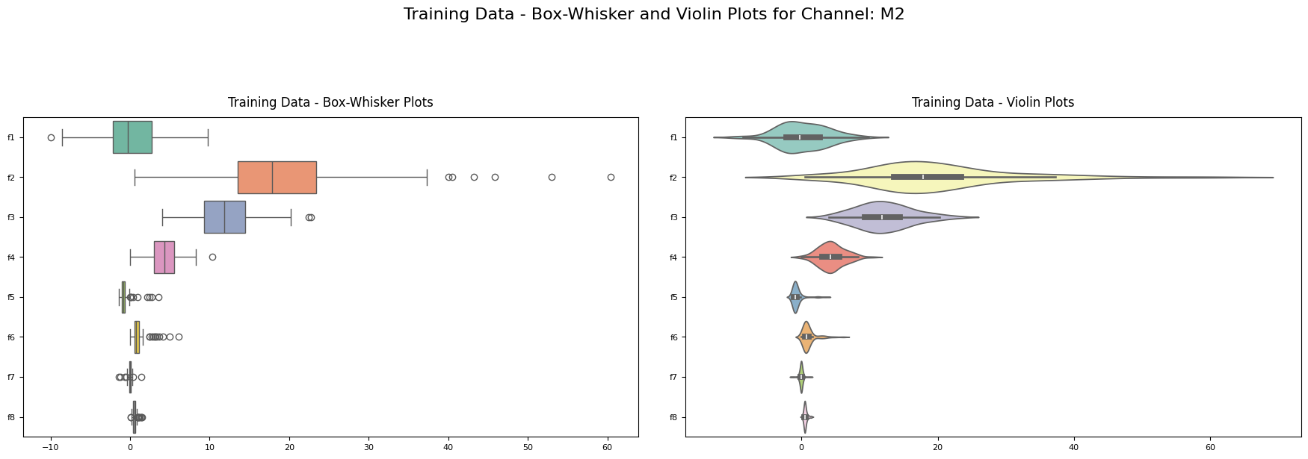
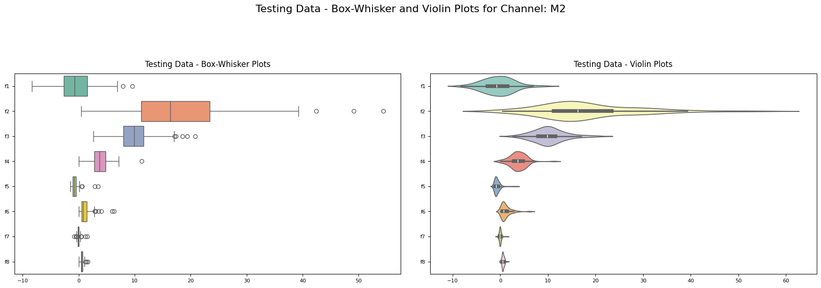
Box-Whisker & Violin Plots for M2

Slide 19
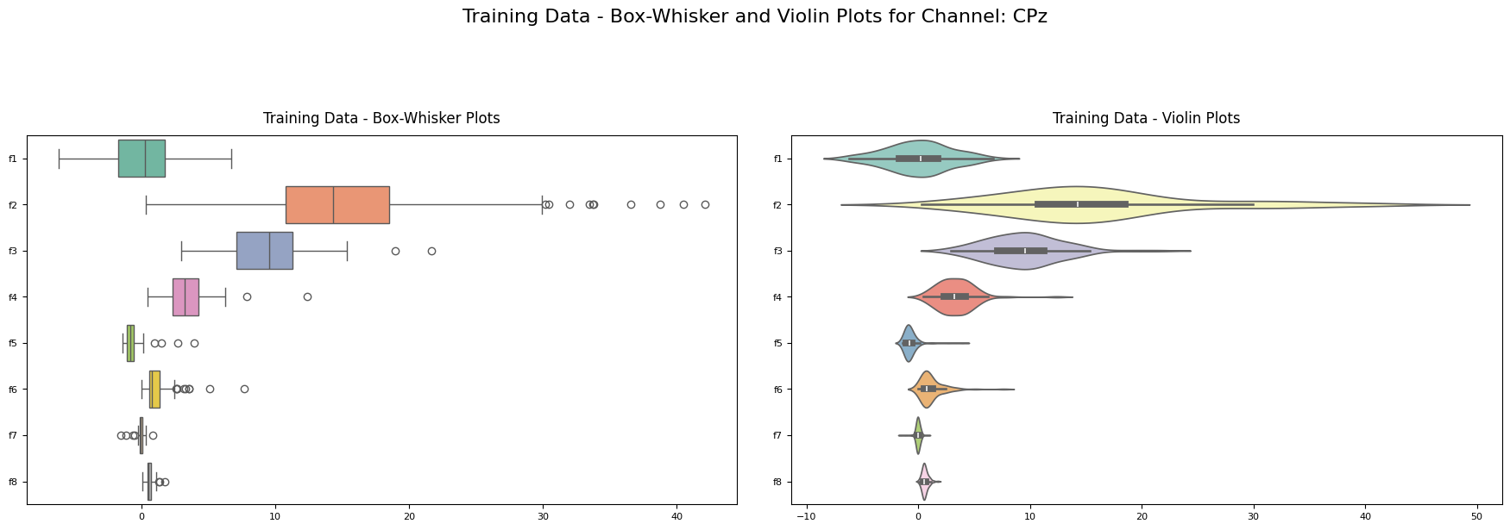
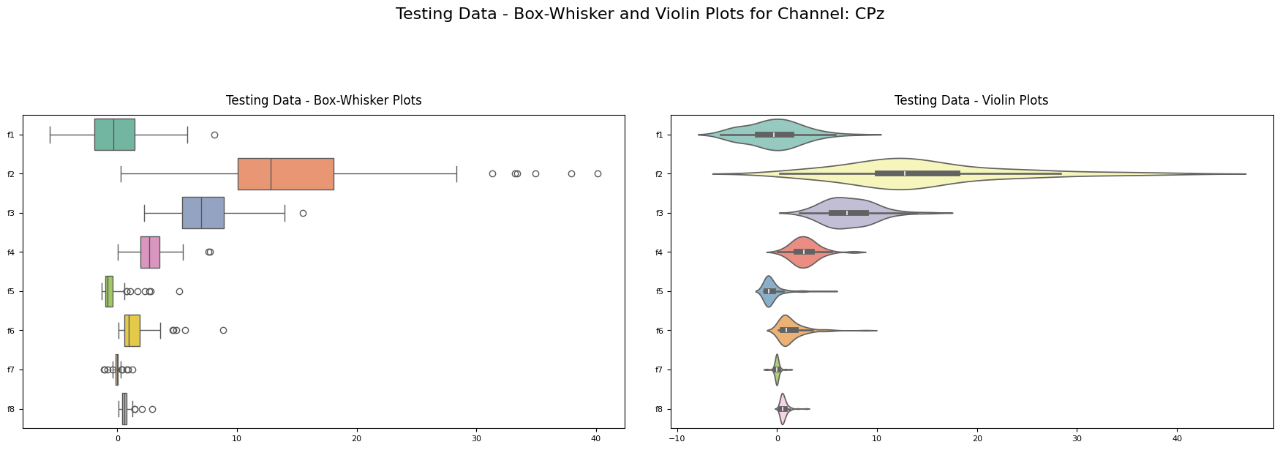
Box-Whisker & Violin Plots for CPz

Slide 20
Evaluation of Clusters
K means Clustering
Cluster Cohesion
Cluster Separation
Recall (sensitivity)
Specificity
F1-measure
Silhouette Score
Clustering examples
Clustering with PCA
Hierarchical clustering dendrogram

Slide 21
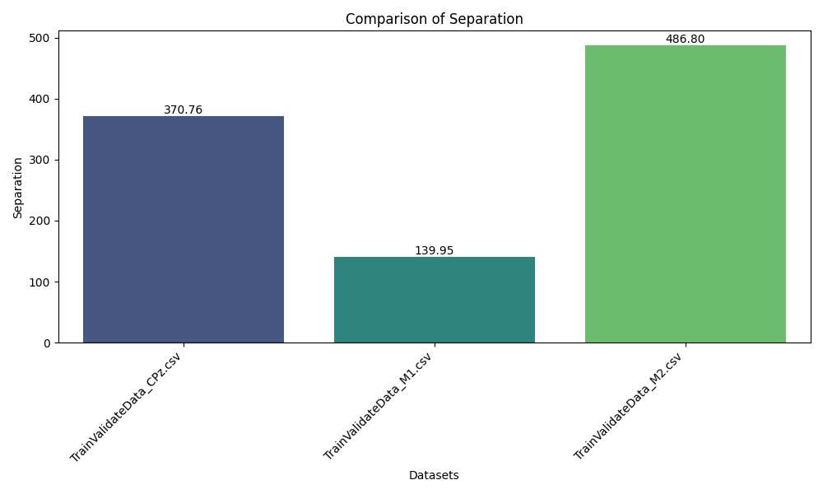
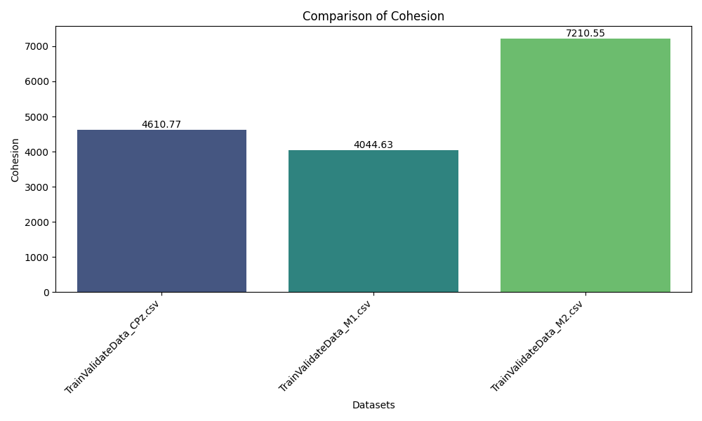
TrainValidateData_M2.csv demonstrates the highest separation (486.80), indicating well-distinguished clusters.
Cohesion is highest for TrainValidateData_M2.csv at 7210.55, implying tighter clusters within this dataset.
A strong trade-off is visible between separation and cohesion. TrainValidateData_M2.csv balances high separation and cohesion, making it ideal for applications prioritizing both compactness and distinct clusters. Conversely, M1 reflects weaker cluster structure with lower separation and cohesion.

Slide 22
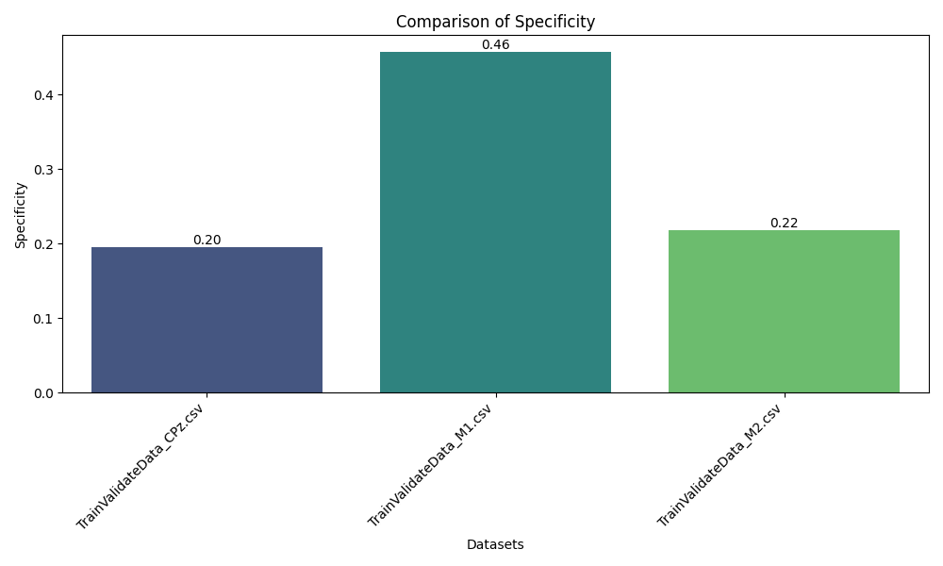
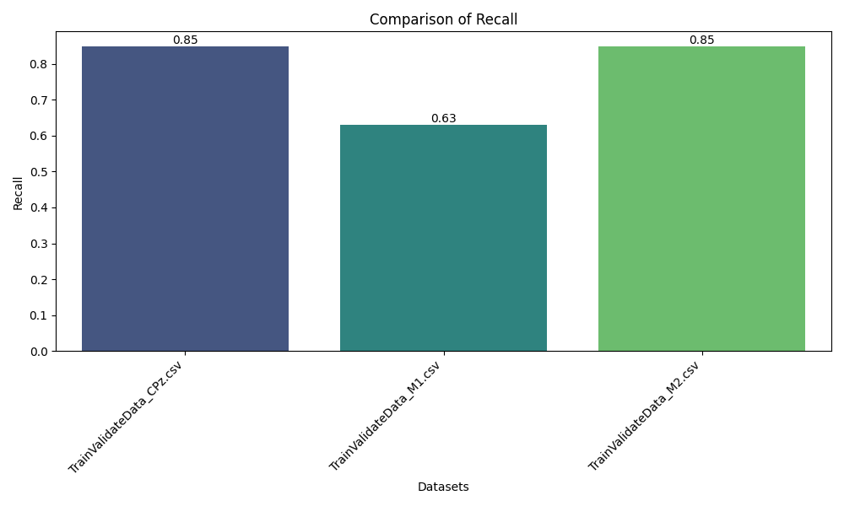
TrainValidateData_M1.csv has the highest specificity (0.46), demonstrating better performance in correctly identifying true negatives.
TrainValidateData_CPz.csv and TrainValidateData_M2.csv achieve the highest recall (0.85), showcasing strong ability to identify true positives.
The results highlight a trade-off between specificity and recall, with M1 showing higher specificity and CPz/M2 excelling in recall, indicating the need for dataset-specific optimization based on the desired balance.

Slide 23
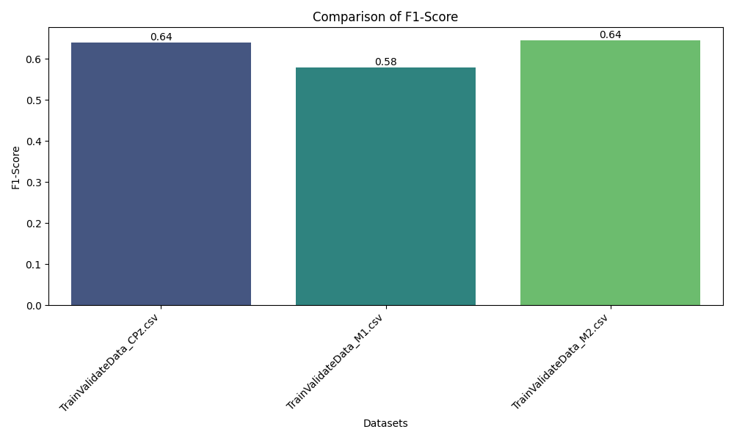
F1-Score Consistency: The datasets TrainValidateData_CPz.csv and TrainValidateData_M2.csv exhibit the highest F1-scores, both at 0.64, indicating a balanced trade-off between precision and recall.
Moderate Performance: TrainValidateData_M1.csv has a slightly lower F1-score of 0.58, suggesting slightly less effective performance in correctly identifying true positives compared to the other two datasets.
Overall Observations: The comparable F1-scores across datasets reflect consistent classification performance, with CPz and M2 standing out as the most balanced datasets in this metric.

Slide 24
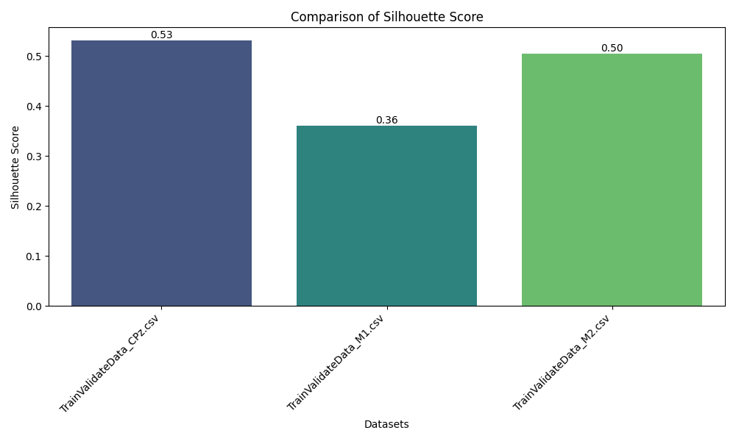
Best Cluster Separation: TrainValidateData_CPz.csv achieves the highest Silhouette Score of 0.53, indicating well-separated and compact clusters compared to the other datasets.
Close Second: TrainValidateData_M2.csv follows with a Silhouette Score of 0.50, showing fairly distinct clustering but slightly less compact than CPz.
Lowest Performance: TrainValidateData_M1.csv has the lowest Silhouette Score of 0.36, suggesting overlapping clusters or less defined groupings in this dataset.

Slide 25
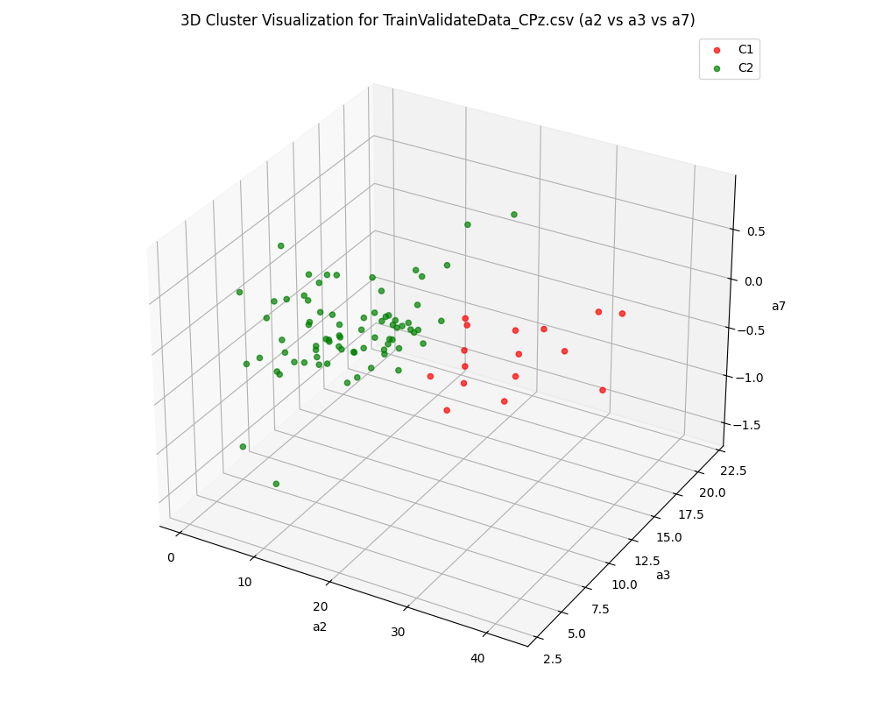
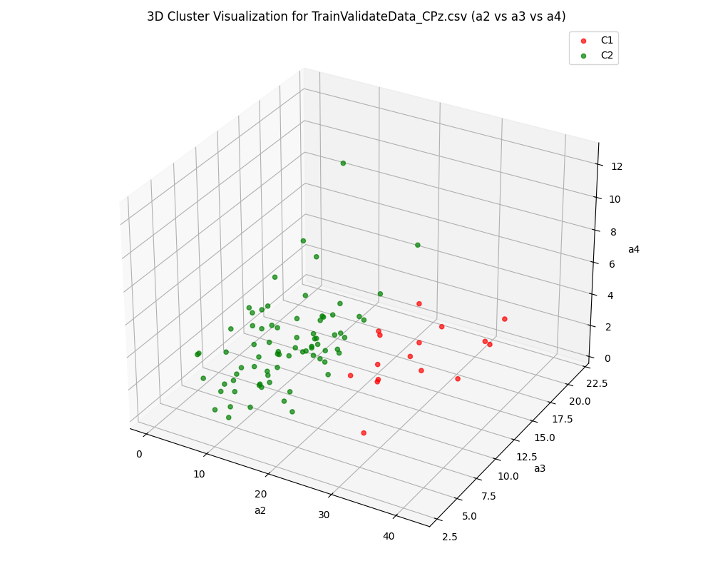
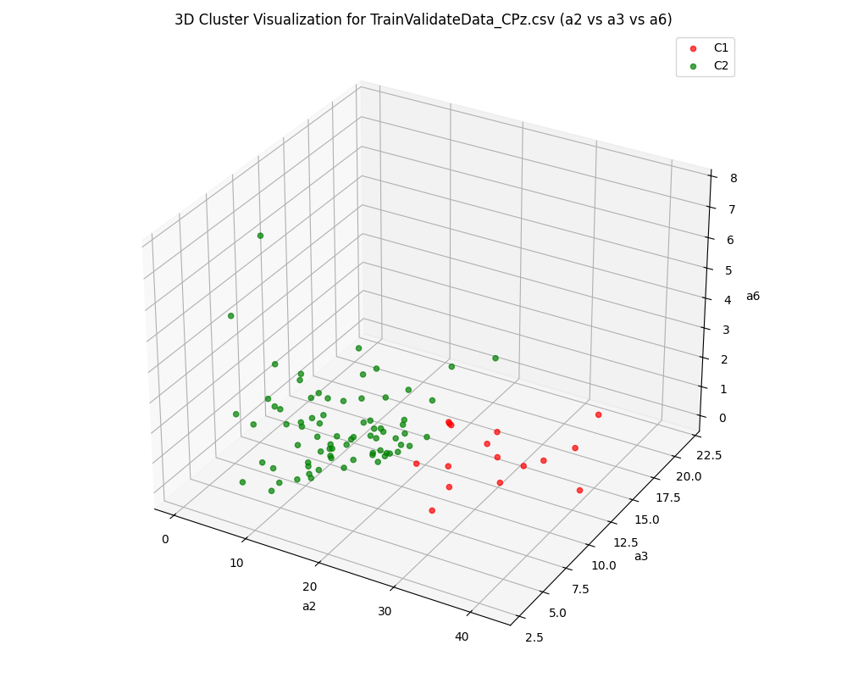
Clustering examples for CPz:
Across all three plots, the clusters (C1 and C2) show moderate separation.
The variation in cluster compactness and separation across plots indicates the relative importance of specific features.

Slide 26
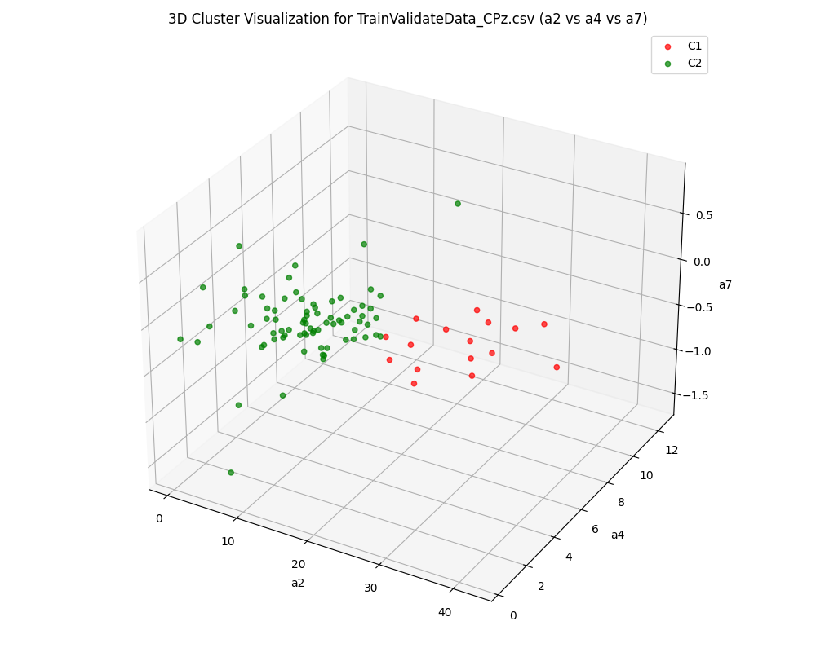
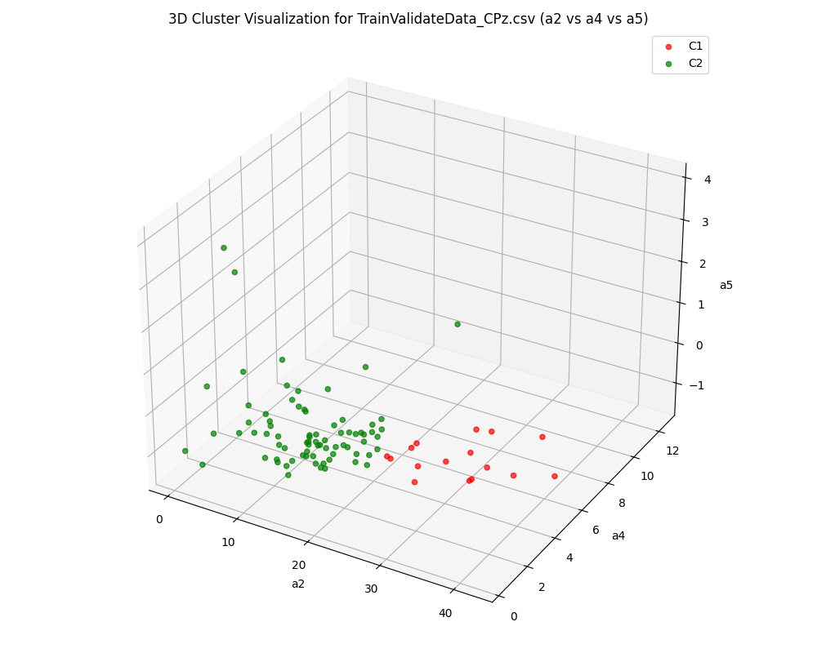

Clustering examples for CPz:
The a2, a3, and a7 combination shows tighter clusters with some overlap in the center.
The a2, a3, and a5 combination exhibits less compactness in C2, suggesting greater dispersion in that cluster.

Slide 27
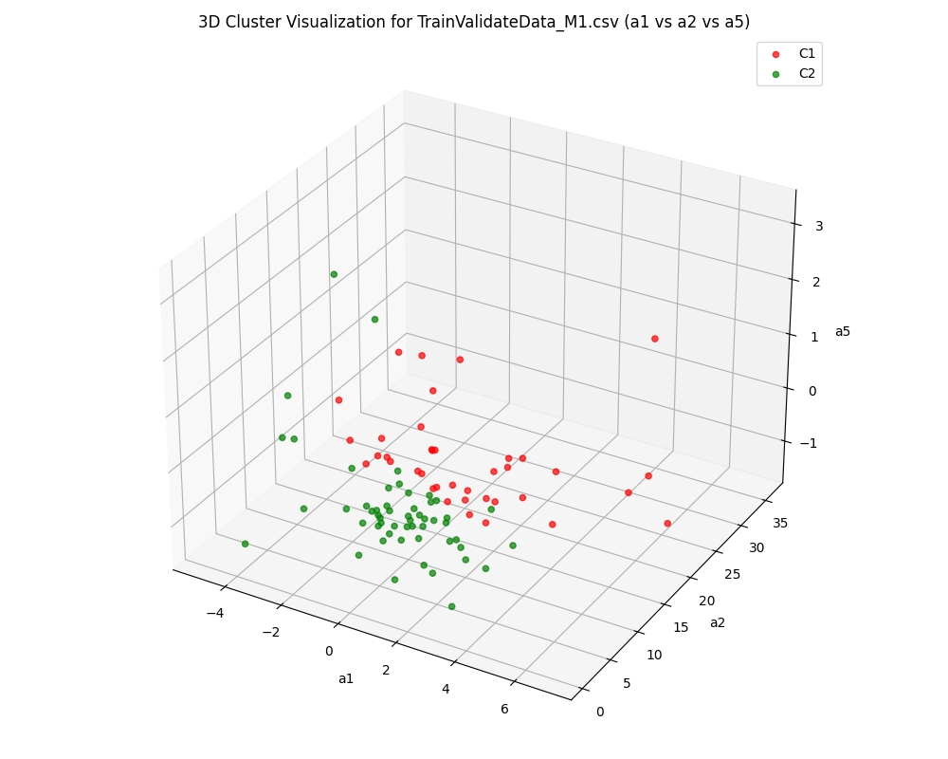
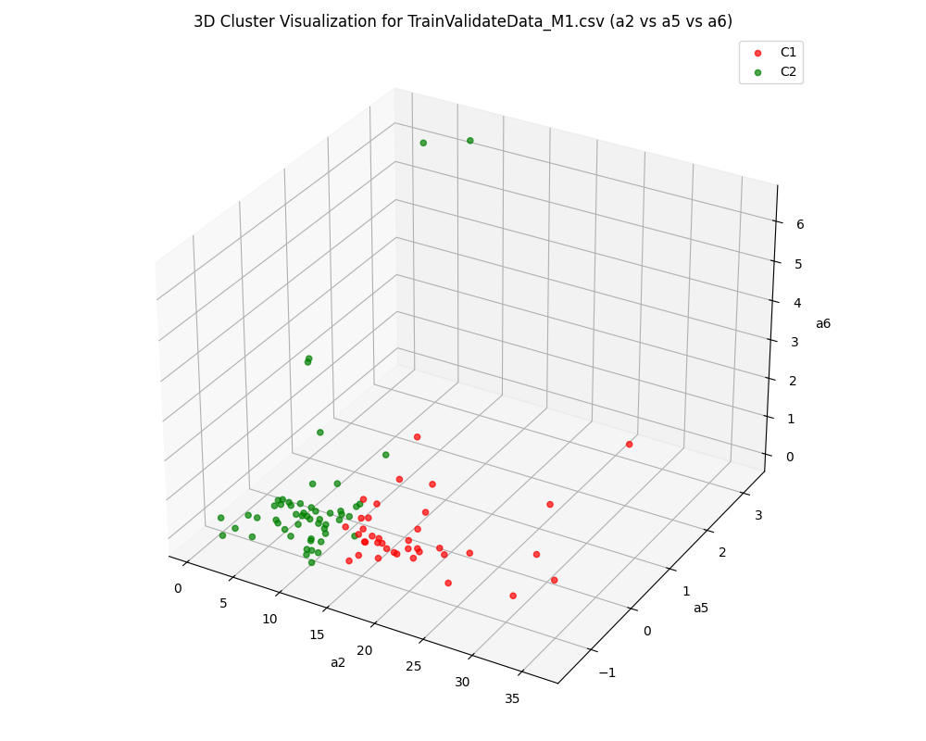
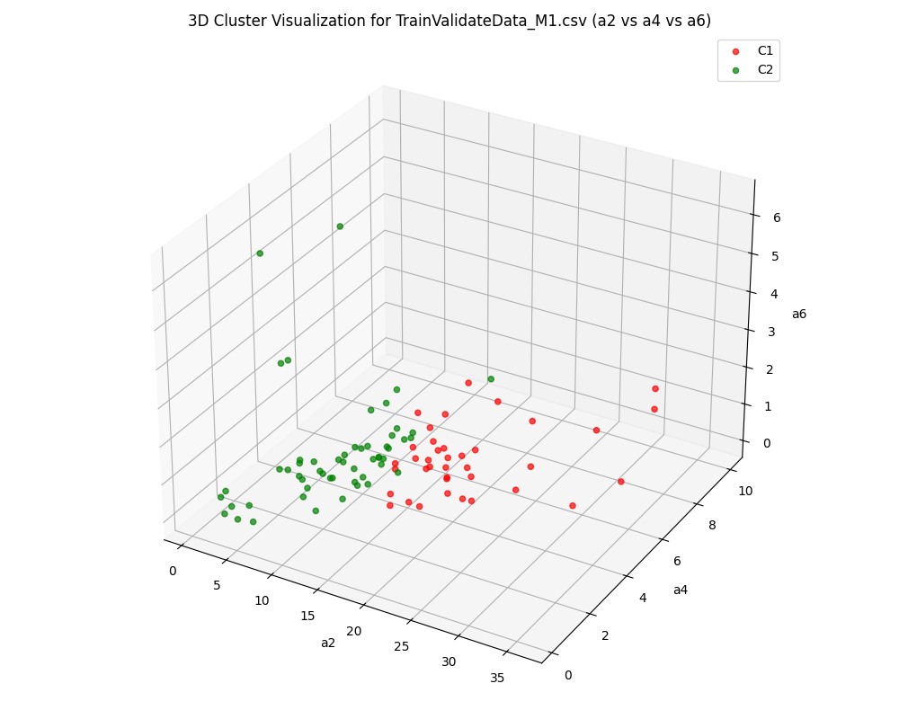
Clustering examples for M1:
The combination of (a2, a5, a6) (second plot) shows improved separation compared to the first plot. This suggests that a5 and a6 contribute to clearer boundaries between clusters.
The (a2, a4, a6) combination (third plot) indicates significant overlap, especially near the cluster boundaries, highlighting that a4 may not significantly enhance cluster differentiation.

Slide 28
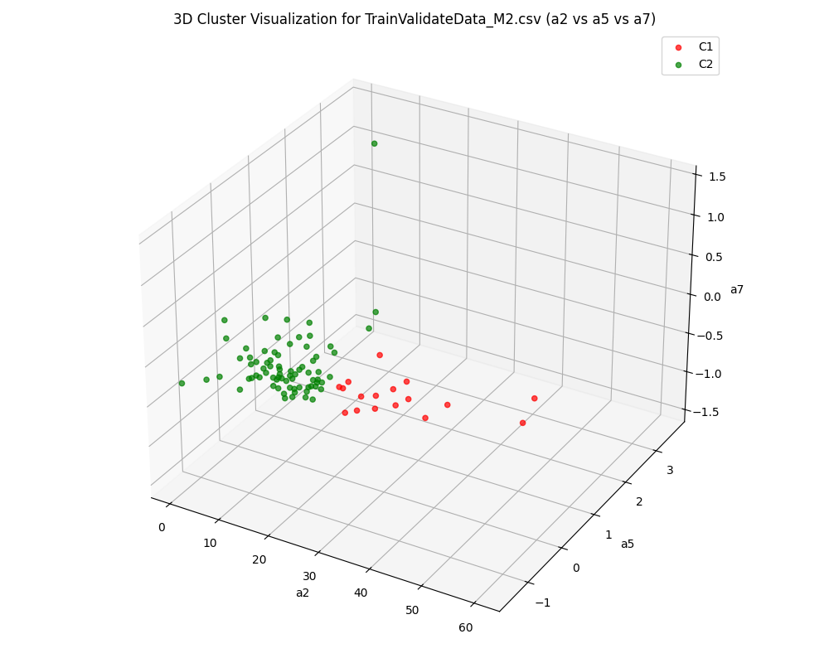
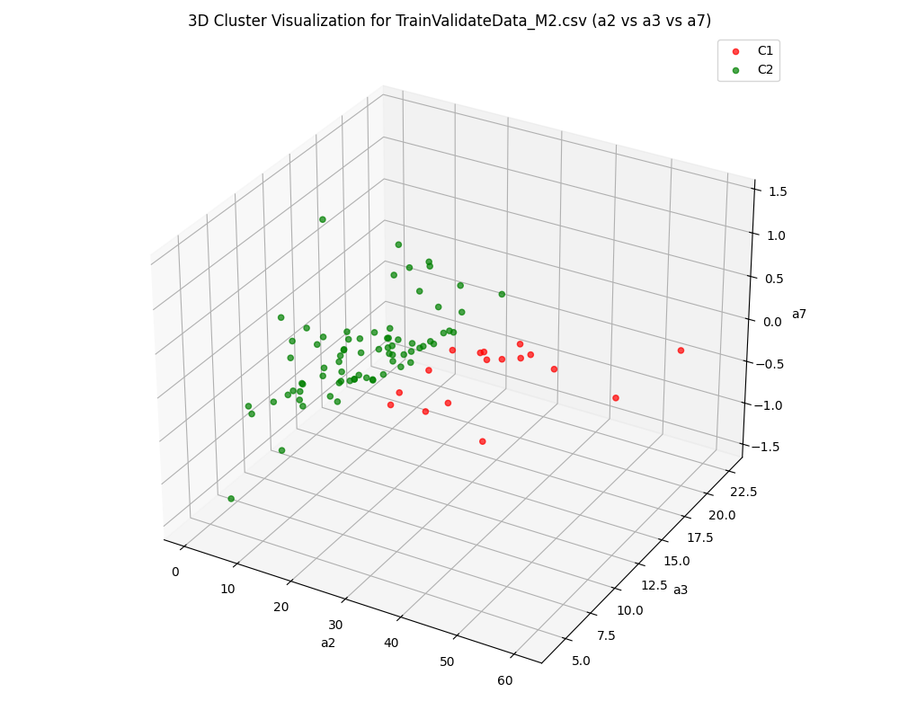
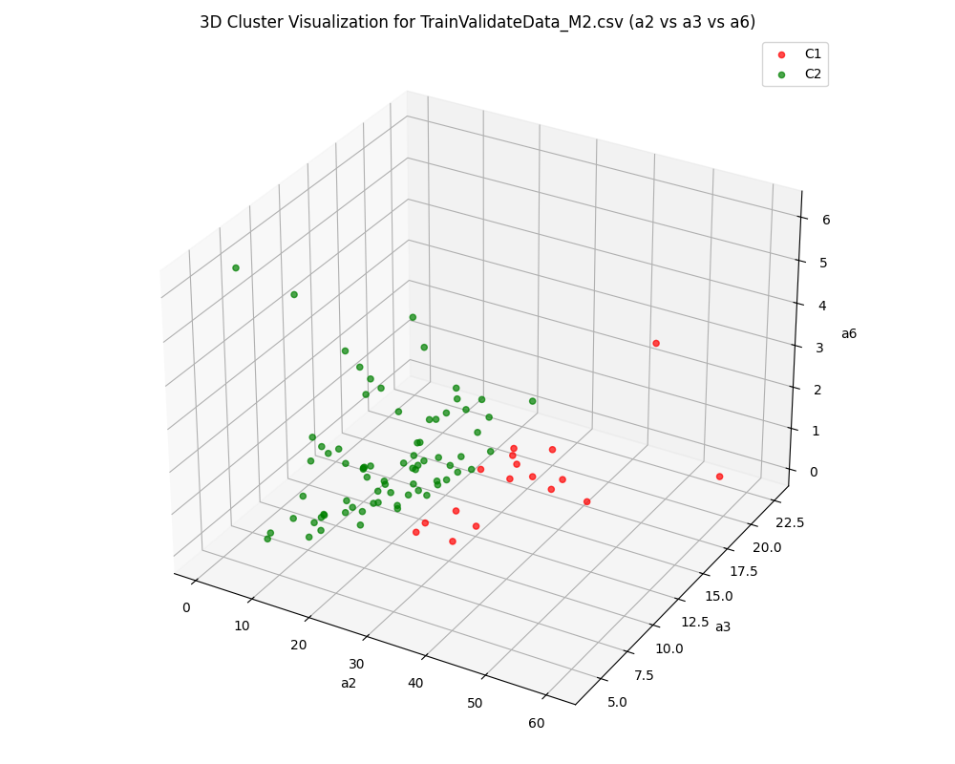
Clustering examples for M2:
In the (a2, a3, a6) combination (third plot), the clusters demonstrate more compact and well-defined structures compared to the (a2, a4, a7) and (a2, a3, a7) combinations.
The inclusion of a6 in the third plot appears to contribute to tighter clusters, indicating its potential importance for distinguishing between groups.

Slide 29
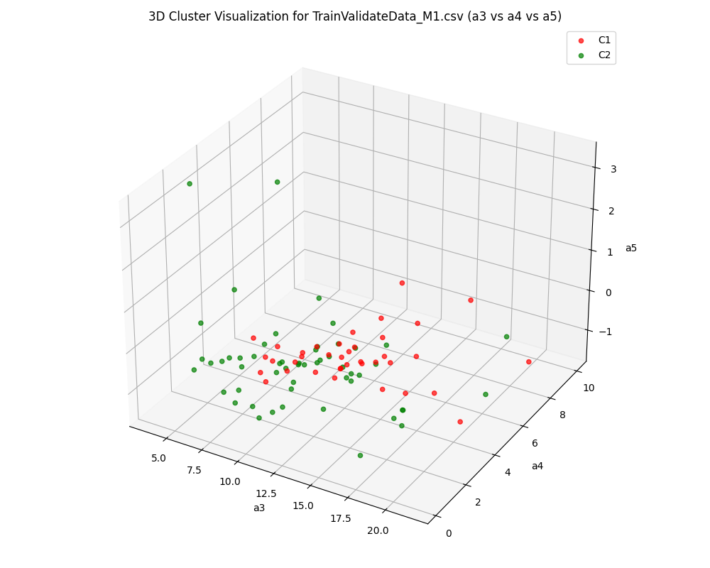
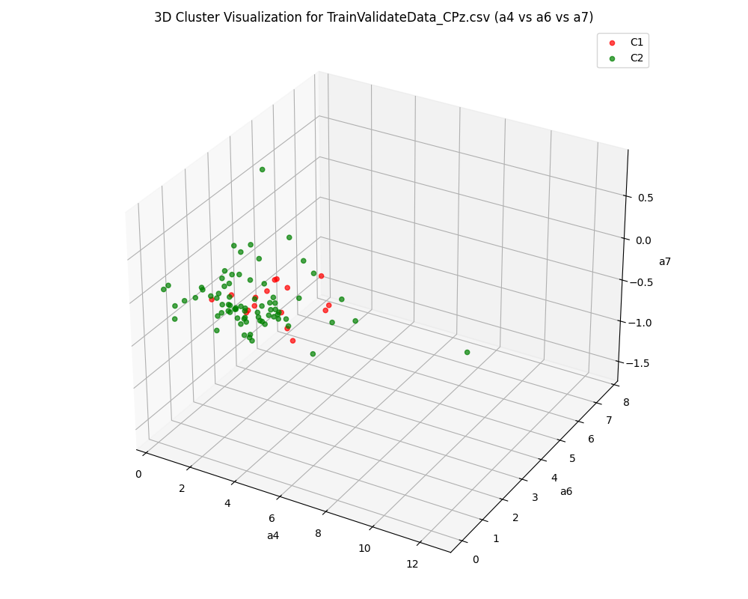
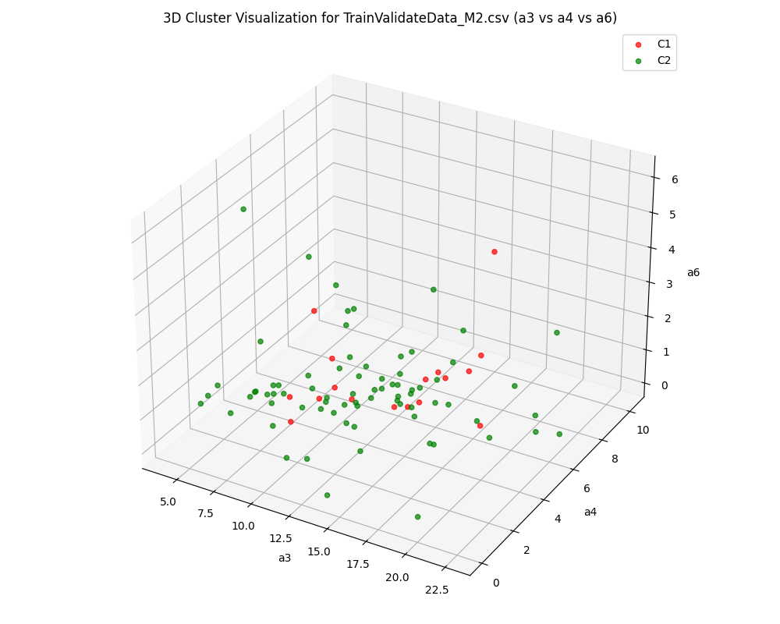
Worst Clustering examples:
Noticeable overlap, indicating weaker clustering performance for certain feature sets.
Feature combinations (e.g., a4, a6, and a7 in the middle plot) contribute more effectively to distinguishing clusters, whereas others (e.g., a3, a4, and a5 in the left plot) result in less separation.

Slide 30
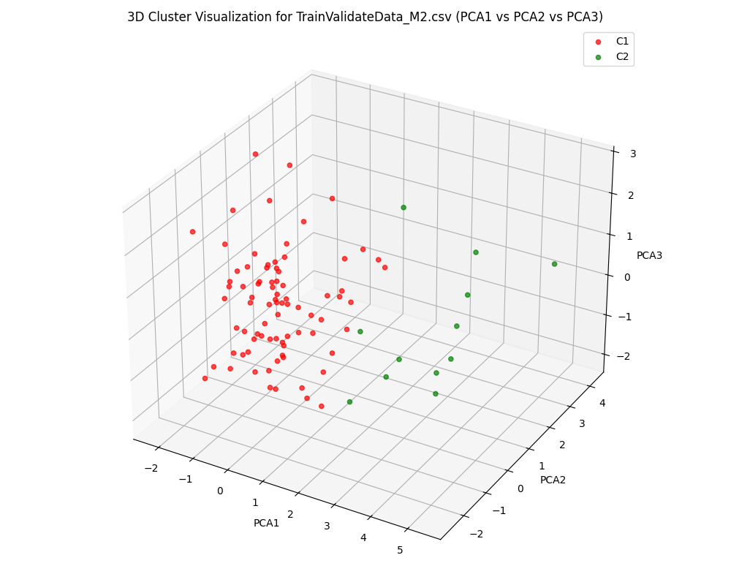
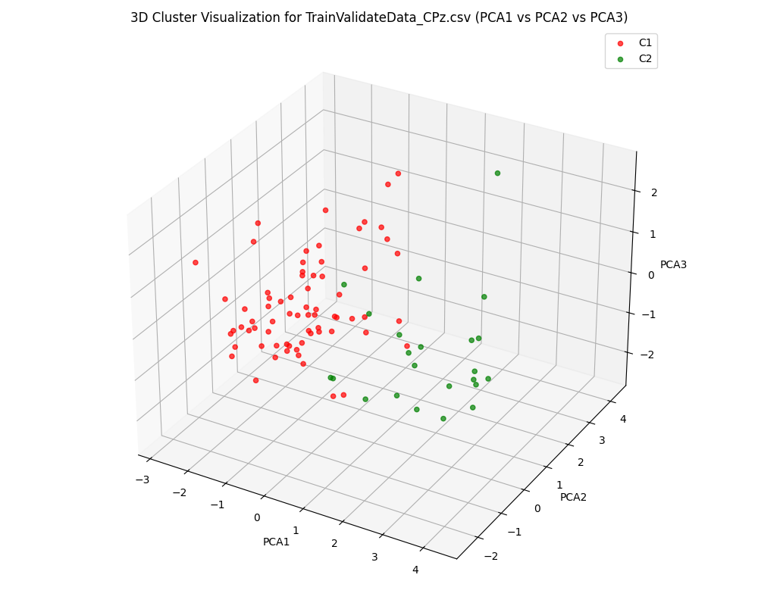
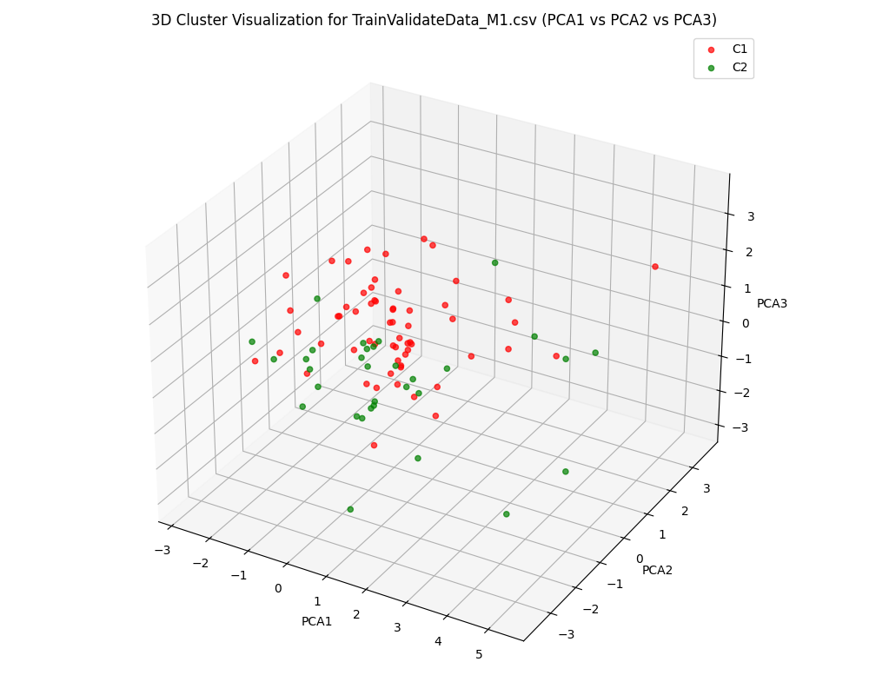
Clustering with PCA
1. Separation of Clusters:
In all three datasets (M1, M2, and CPz), clusters C1 (red) and C2 (green) show a noticeable separation in the PCA space. However, the degree of separation varies between datasets.
For TrainValidateData_M2.csv, the red cluster dominates the distribution, with fewer green points, indicating a potential imbalance or less distinguishable clusters.

Slide 31
Clustering with PCA
2. Cluster Compactness:
The TrainValidateData_CPz.csv visualization shows relatively compact and well-separated clusters, suggesting better-defined groupings.
The TrainValidateData_M1.csv plot displays more overlap between clusters, which could indicate challenges in distinguishing data points based on the chosen features.
3. Insights from PCA:
PCA highlights the main variance in the datasets. The variations among these plots suggest differences in data complexity or the relationships between original features across the datasets.
Conclusion:
The PCA-based clustering is effective for visualizing separability, with CPz appearing to have the most well-separated clusters, while M2 shows significant dominance by one cluster. Additional fine-tuning of feature selection or clustering parameters could improve cluster quality in datasets like M1 and M2.

Slide 32
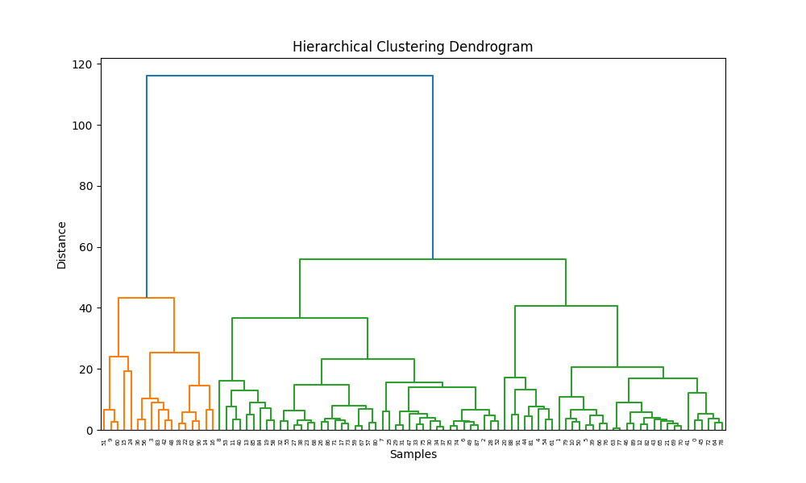

Slide 33
Hierarchical Clustering Visualization
Hierarchical Clustering Visualization: The dendrogram represents the hierarchical clustering of data points, showing the process of merging clusters based on their distance.
Cluster Structure: The orange and green branches highlight distinct groups in the data, with the height of the branches indicating the distance at which clusters were merged.
Cutoff Threshold: The large blue branch suggests the optimal point to cut the dendrogram and form clusters, dividing the data into two main groups for analysis.
Subcluster Density: Within the two major clusters, smaller subclusters are observed with varying branch lengths. Shorter branches indicate tightly packed data points, while longer branches represent more spread-out subgroups.
Optimal Threshold: Based on the dendrogram, the optimal cutoff for clustering can be set at around a height of 50, where two clear clusters emerge. This threshold balances granularity and separation effectively.

